Slide 1
THE LIFE OF CHRIST

Slide 2
1. One of the most important things you must do is to look at the context so you can know what is going on. This means you need to look at the previous chapter as it may give you great insight to what is going on.
2. Also, it's important to examine any other verses or parallel accounts of the contents of the chapter you want to examine.
3. When you are examining a more difficult chapter, try to find verses within that chapter that might help you unlock the true meaning of the text.

Slide 3
Matthew 23:32 "Fill up, then, the measure of your fathers' guilt. 33 "Serpents, brood of vipers! How can you escape the condemnation of hell? 34 "Therefore, indeed, I send you prophets, wise men, and scribes: some of them you will kill and crucify, and some of them you will scourge in your synagogues and persecute from city to city, 35 "that on you may come all the righteous blood shed on the earth, from the blood of righteous Abel to the blood of Zechariah, son of Berechiah, whom you murdered between the temple and the altar. 36 "Assuredly, I say to you, all these things will come upon this generation. 37 " O Jerusalem, Jerusalem, the one who kills the prophets and stones those who are sent to her! How often I wanted to gather your children together, as a hen gathers her chicks under her wings, but you were not willing! 38 "See! Your house is left to you desolate;

Slide 4
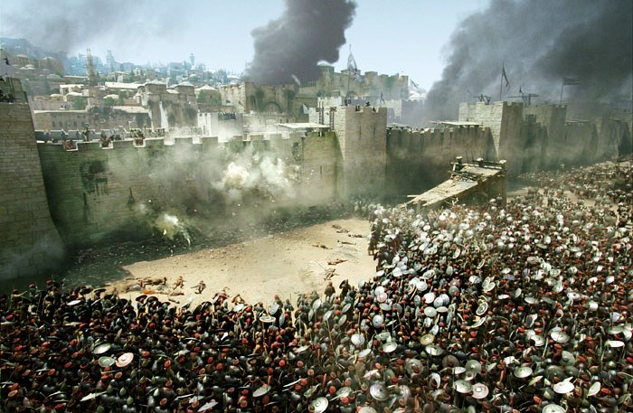

Slide 5
Matthew 24:34 "Assuredly, I say to you, this generation will by no means pass away till all these things take place.

Slide 6
Instead, the word generation is almost always defined as,
“the sum total of those born at the same time, expanded to include all those living at a given time”

Slide 7
Matthew 1:17 So all the generations from Abraham to David are fourteen generations;

Slide 8
My goal is to show you that Mt. 24 talks about 2 different events. Verses 1 – 34 talk about the destruction of Jerusalem, and verses 36 – 51 talk about Jesus’ second coming when the end of the world will occur.

Slide 9
Matthew 24:1 Then Jesus went out and departed from the temple, and His disciples came up to show Him the buildings of the temple. ² And Jesus said to them, "Do you not see all these things? Assuredly, I say to you, not one stone shall be left here upon another, that shall not be thrown down." ³ Now as He sat on the Mount of Olives, the disciples came to Him privately, saying…

Slide 10
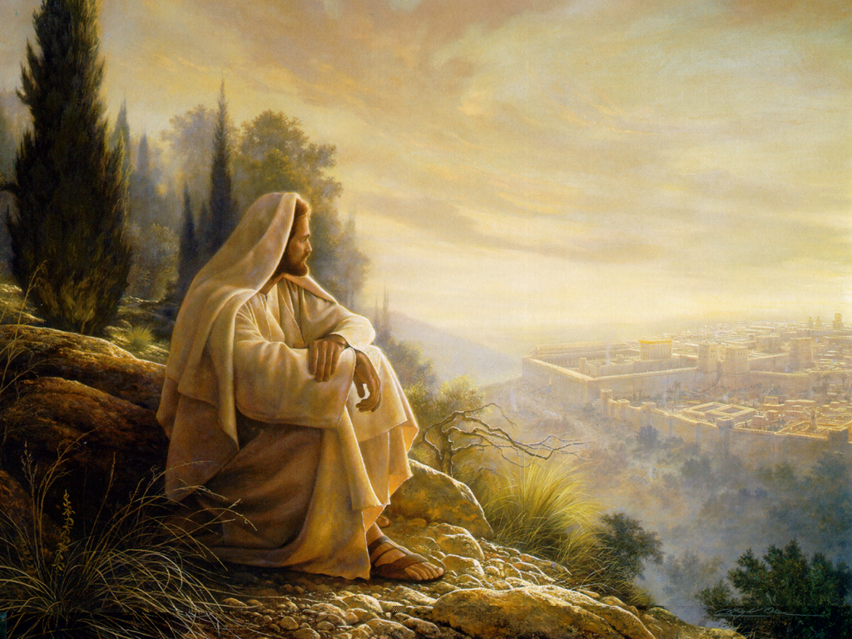

Slide 11
In Matthew’s account, we see 3 questions. Matthew 24:3 "Tell us, when will these things be? And what will be the sign of Your coming, and of the end of the age?"
Luke’s account shows 2 questions.
Luke 21:7 So they asked Him, saying, "Teacher, but when will these things be? And what sign will there be when these things are about to take place?"
Mark’s account also shows 2 questions
Mark 13:4 "Tell us, when will these things be? And what will be the sign when all these things will be fulfilled?"

Slide 12
Jesus taught them multiple times about His death and resurrection, yet in John 20:9, after Jesus’ death on the cross, they still didn’t understand that He must be raised from the dead.

Slide 13
Another example can be seen in Mt. 13 when Jesus spoke several parables about the kingdom that was to come, which was spiritual and not physical. He also taught them about the end of the world or the end of the age. When He was done, He asked them if they understood what He was talking about, and they all said “yes we understand” in verse 51. Yet, when we come to Acts 1:6, just before Jesus is about to ascend into heaven, His disciples want to know when He will restore the kingdom to Israel?

Slide 14
Matthew 24:4 And Jesus answered and said to them: "Take heed that no one deceives you. ⁵ "For many will come in My name, saying, 'I am the Christ,' and will deceive many.

Slide 15
The Bible tells us in Acts 5:35-37 that some men had claimed to be something great and led some people away to a slaughter, and it also mentions an Egyptian who did this as well in Acts 21:38.

Slide 16
Matthew 24:6 "And you will hear of wars and rumors of wars. See that you are not troubled; for all these things must come to pass, but the end is not yet. ⁷ "For nation will rise against nation, and kingdom against kingdom. And there will be famines, pestilences, and earthquakes in various places. ⁸ "All these are the beginning of sorrows.

Slide 17
Vincent notes that between this prophecy by Jesus in 30 A.D. and the destruction of Jerusalem there was an earthquake in Crete in 46-47 A.D., at Rome in 51 A.D., at Apamaia in Phrygia in 60 A.D., and at Campania in 41 -54 A.D. He also notes 4 famines during the reign of Claudius in 41 – 54 A.D. One of these famines is mentioned in taught in Acts 11:28. Also an early writer named Tacitus (Annals xvi. 10-13) describes hurricanes and storms in Campania in A.D. 65.

Slide 18
Matthew 24:9 "Then they will deliver you up to tribulation and kill you, and you will be hated by all nations for My name's sake.

Slide 19
The apostles were beaten and put in prison (Acts 4-5)
Stephen was stoned to death (Acts 6-7)
There was a great persecution against the church (Acts 8-9)
James was beheaded (Acts 12:1-2)

Slide 20
Mark 13:11 "But when they arrest you and deliver you up, do not worry beforehand, or premeditate what you will speak. But whatever is given you in that hour, speak that; for it is not you who speak, but the Holy Spirit.

Slide 21
1 Cor. 13, Eph. 4, and other passages make it clear the miraculous speaking of tongues and the like were limited to the 1st century because once God’s Word was fully revealed, miracles would cease.

Slide 22
Matthew 24:10 "And then many will be offended, will betray one another, and will hate one another. ¹¹ "Then many false prophets will rise up and deceive many. ¹² "And because lawlessness will abound, the love of many will grow cold. ¹³ "But he who endures to the end shall be saved.
See 2 Tim 4:10, 16

Slide 23
"Tacitus, the Roman historian, records, `that several Christians at first were apprehended, and then by their discovery, a multitude of others were convicted, and cruelly put to death, with derision and insult!'"

Slide 24
Luke’s account adds that not one hair of their heads would be lost (Lk. 21:18).

Slide 25
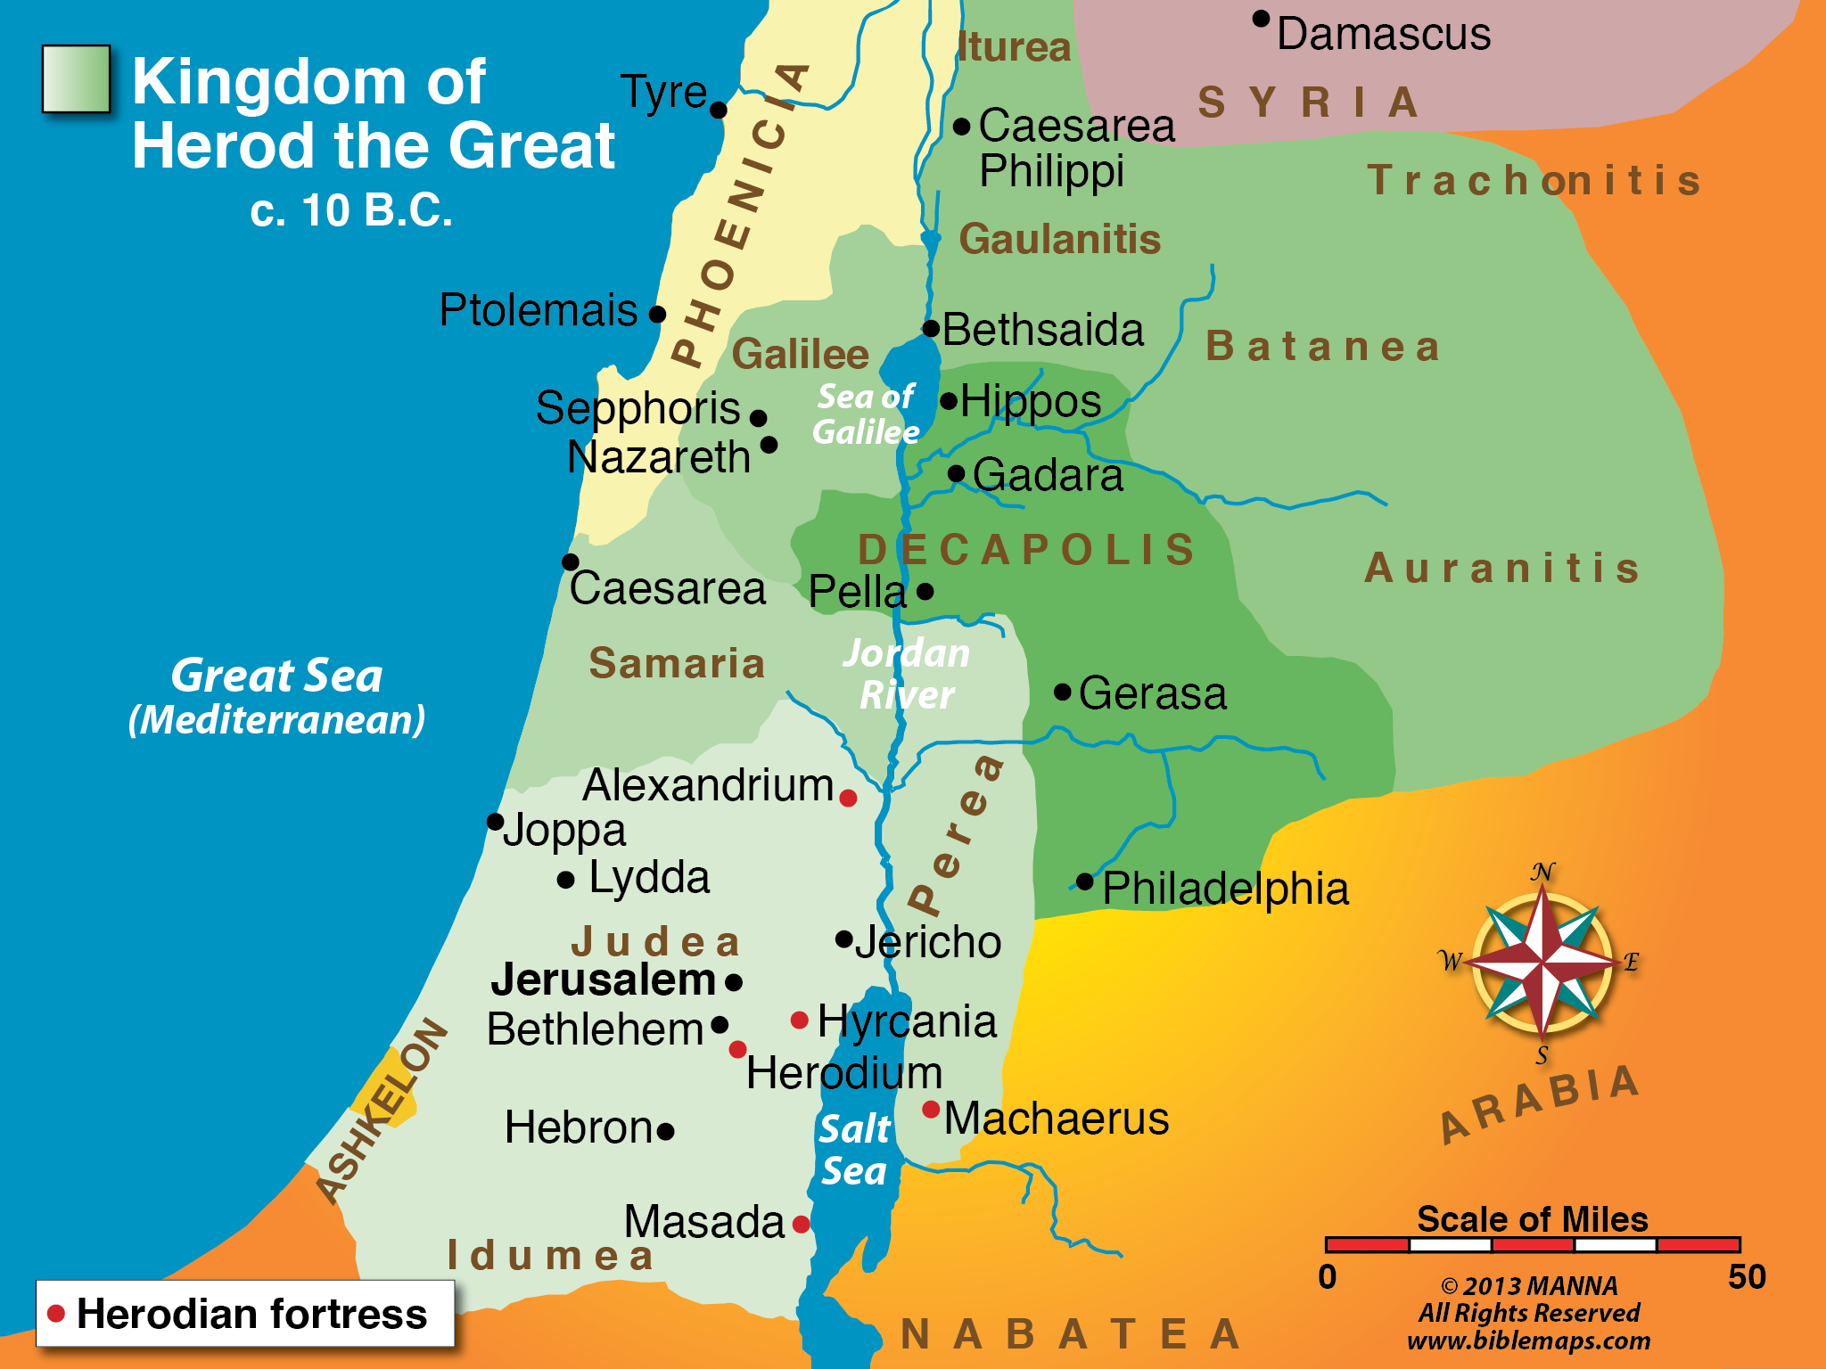

Slide 26
Matthew 24:14 "And this gospel of the kingdom will be preached in all the world as a witness to all the nations, and then the end will come.

Slide 27
Colossians 1:5 because of the hope which is laid up for you in heaven, of which you heard before in the word of the truth of the gospel, ⁶ which has come to you, as it has also in all the world,
Colossians 1:23 if indeed you continue in the faith, grounded and steadfast, and are not moved away from the hope of the gospel which you heard, which was preached to every creature under heaven, of which I, Paul, became a minister.

Slide 28
Also, Romans 10:18 and 16:26 all show that the gospel had indeed been preached to all the world. The Book of Colossians was written around 61 - 63 A.D. and the Book of Romans was written around 57-58 A.D., which clearly shows that the gospel had been preached to all the world before the destruction of Jerusalem in A.D. 70.

Slide 29
Matthew 24:15 " Therefore when you see the 'abomination of desolation,' spoken of by Daniel the prophet, standing in the holy place" (whoever reads, let him understand),
The word ‘abomination’ means detestable things such as idolatry, and the word ‘desolation’ means destruction.
See Daniel 9, 11, and 12, but more specifically Daniel 9: 24-27.

Slide 30
Luke 21:20 But when you see Jerusalem surrounded by armies, then know that its desolation is near.

Slide 31
Luke 19:41 Now as He drew near, He saw the city and wept over it, ⁴² saying, "If you had known, even you, especially in this your day, the things that make for your peace! But now they are hidden from your eyes. ⁴³ "For days will come upon you when your enemies will build an embankment around you, surround you and close you in on every side, ⁴⁴ "and level you, and your children within you, to the ground; and they will not leave in you one stone upon another, because you did not know the time of your visitation."

Slide 32
In the very same manner Daniel also wrote concerning the Roman Government, and that our country should be made desolate by them. (Josephus, Antiquities of the Jews, 10:11:7)

Slide 33
And now the Romans, upon the flight of the seditious into the city, and upon the burning of the holy house itself, and of all the buildings lying round about it, brought their ensigns to the temple, and set them over against its eastern gate, and there did they make Titus imperator. (Josephus, War of the Jews, 6:6:1)

Slide 34
THE LIFE OF CHRIST

Slide 35
Matthew 24:15 Therefore when you see the 'abomination of desolation,' spoken of by Daniel the prophet, standing in the holy place" (whoever reads, let him understand), 16 "then let those who are in Judea flee to the mountains. 17 "Let him who is on the housetop not go down to take anything out of his house. 18 "And let him who is in the field not go back to get his clothes.

Slide 36
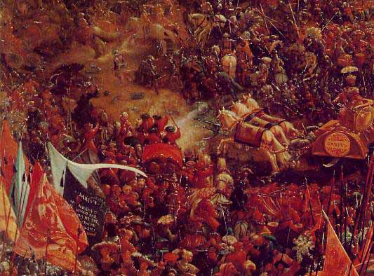

Slide 37
Matthew 24:19 "But woe to those who are pregnant and to those who are nursing babies in those days! ²⁰ "And pray that your flight may not be in winter or on the Sabbath.
Also Nehemiah 13:19.

Slide 38
Matthew 24:21 "For then there will be great tribulation, such as has not been since the beginning of the world until this time, no, nor ever shall be. ²² "And unless those days were shortened, no flesh would be saved; but for the elect's sake those days will be shortened.

Slide 39
Starting in A.D. 66, the Jews and Romans began fighting each other. Most believe the Zealots were the instigators of this struggle. Josephus records in his book THE WAR OF JEWS book 2 chapter 19 about how the Roman General Cestius surrounded Jerusalem in A.D. 66, but for no apparent reason he left his siege of Jerusalem. In fact, notice was Josephus writes:

Slide 40
"It then happened that Cestius was not conscious either how the besieged despaired of success, nor how courageous the people were for him; and so he recalled his soldiers from the place, and by despairing of any expectation of taking it, without having received any disgrace, he retired from the city, without any reason in the world." (Wars, II, XIX, 6,7)

Slide 41
This certainly would have been a wakeup call for the Christians of that day who were taught what Jesus had said. From A. D. 66, not only were the Romans fighting the Jews, the Jews were undergoing a civil war.

Slide 42
If you ever get a chance, you can read about these events in the Josephus’ book. From his book, you can learn just how great the tribulation was during that time. When Titus came in A.D. 70, he came during the time of the Passover, so the city was full to capacity with the Jews who had traveled from afar to partake of the Passover and the events surrounding it. They locked up the city when he came, but someone burned their food source in the city, which they could have survived on for a long time, but now a great famine begins within the walls. Since there was a civil war going on inside the city, the dead bodies began to pile up within the temple area, which was an abomination within itself.

Slide 43
In a similar instance as found in 2 Kings 6:24 -30, a woman was so hungry that she did the unthinkable. She killed her baby and ate it. The Romans crucified around 500 Jews a day. After all was said and done, around 1,100,000 Jews were killed and 97,000 were captured.

Slide 44
This is an ugly scene, but it was just as Jesus said it would be. As I said earlier, not one Christian is recorded as being put to death by the Romans during this siege in A.D. 70. Josephus also tells us that the temple was destroyed on the same day and month as Solomon’s temple was earlier in history. I have always found this little fact to be interesting.

Slide 45
One more interesting point is that when the temple caught fire, the gold ran down through the stones of the temple and this is one of the reasons the soldiers did not leave one stone unturned because they wanted to get all the gold they could.

Slide 46
Matthew 24:23 "Then if anyone says to you, 'Look, here is the Christ!' or 'There!' do not believe it. ²⁴ "For false christs and false prophets will rise and show great signs and wonders to deceive, if possible, even the elect. ²⁵ "See, I have told you beforehand. ²⁶ "Therefore if they say to you, 'Look, He is in the desert!' do not go out; or 'Look, He is in the inner rooms!' do not believe it. ²⁷ "For as the lightning comes from the east and flashes to the west, so also will the coming of the Son of Man be.

Slide 47
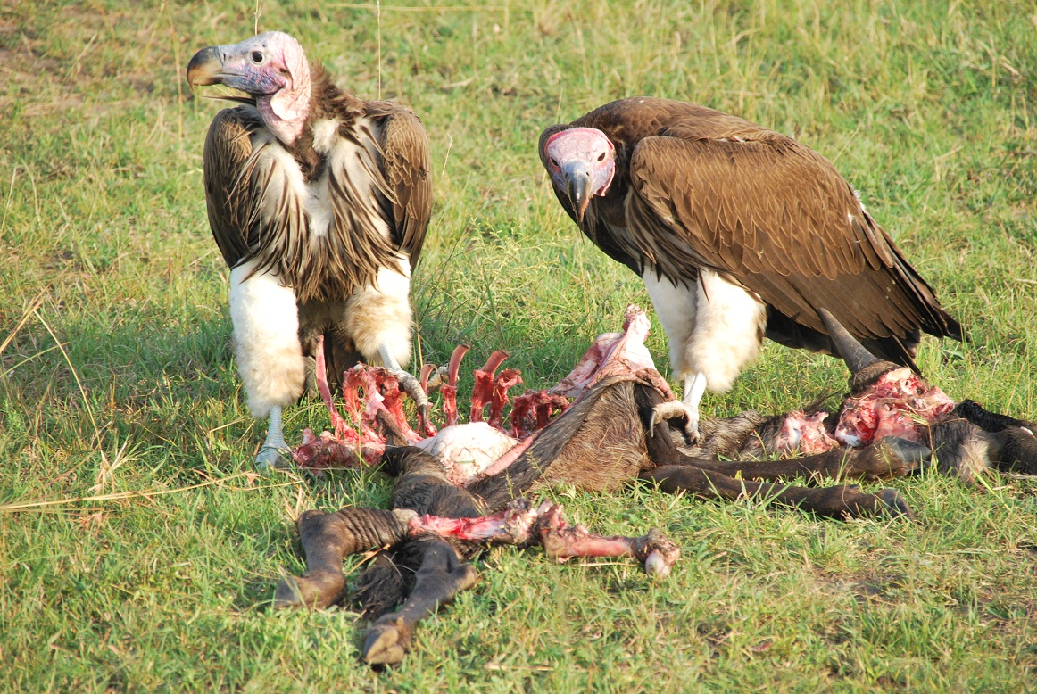
²⁸ "For wherever the carcass is, there the eagles will be gathered together.
The word eagle or vulture was used in the OT to describe a foreign nation coming against the Jewish nation for punishment (Deut. 28:49; Hos. 8:1; Hab. 1:8).

Slide 48
Matthew 24:29 " Immediately after the tribulation of those days the sun will be darkened, and the moon will not give its light; the stars will fall from heaven, and the powers of the heavens will be shaken.

Slide 49
Isaiah’s prophecy about the downfall of Babylon.
Isaiah 13:10 For the stars of heaven and their constellations Will not give their light; The sun will be darkened in its going forth, And the moon will not cause its light to shine. See Isa. 13:19-20

Slide 50
Ezekiel talks about the downfall of Egypt.
Ezekiel 32:7 When I put out your light, I will cover the heavens, and make its stars dark; I will cover the sun with a cloud, And the moon shall not give her light. 8 All the bright lights of the heavens I will make dark over you, And bring darkness upon your land,' Says the Lord GOD.

Slide 51
Matthew 24:29 " Immediately after the tribulation of those days the sun will be darkened, and the moon will not give its light; the stars will fall from heaven, and the powers of the heavens will be shaken.

Slide 52
Matthew 24:30 "Then the sign of the Son of Man will appear in heaven, and then all the tribes of the earth will mourn, and they will see the Son of Man coming on the clouds of heaven with power and great glory.

Slide 53
Matthew 26:64 Jesus said to him, "It is as you said. Nevertheless, I say to you, hereafter you will see the Son of Man sitting at the right hand of the Power, and coming on the clouds of heaven."

Slide 54
“coming on the clouds of heaven with power” is another phrase that we can see used in OT on how the Lord would come against a nation by means of an earthly force.
Isaiah 19:1 The burden against Egypt. Behold, the LORD rides on a swift cloud, And will come into Egypt; The idols of Egypt will totter at His presence, And the heart of Egypt will melt in its midst. 2 "I will set Egyptians against Egyptians; Everyone will fight against his brother, And everyone against his neighbor, City against city, kingdom against kingdom.

Slide 55
Matthew 24:31 "And He will send His angels with a great sound of a trumpet, and they will gather together His elect from the four winds, from one end of heaven to the other.

Slide 56
Matthew 24:32 Now learn this parable from the fig tree: When its branch has already become tender and puts forth leaves, you know that summer is near. ³³ "So you also, when you see all these things, know that it is near -- at the doors! 34 "Assuredly, I say to you, this generation will by no means pass away till all these things take place.

Slide 57
Matthew 23:36 "Assuredly, I say to you, all these things will come upon this generation.
Matthew 24:2 "Do you not see all these things? Referring to the buildings of the temple.
Matthew 24:3 "Tell us, when will these things be?
Matthew 24:6 See that you are not troubled; for all these things must come to pass

Slide 58
Matthew 24:8 "All these are the beginning of sorrows.
Luke 21:26 "men's hearts failing them from fear and the expectation of those things which are coming on the earth
Luke 21:31 "So you also, when you see these things happening, know that the kingdom of God is near.

Slide 59
Matthew 24:19 "But woe to those who are pregnant and to those who are nursing babies in those days!
Matthew 24:22 "And unless those days were shortened, no flesh would be saved; but for the elect's sake those days will be shortened.
Matthew 24:29 " Immediately after the tribulation of those days the sun will be darkened…

Slide 60
Matthew 24:35 "Heaven and earth will pass away, but My words will by no means pass away.

Slide 61
Matthew 24:36 But of that day and hour no one knows, not even the angels of heaven, but My Father only.

Slide 62
Matthew 12:36 "But I say to you that for every idle word men may speak, they will give account of it in the day of judgment.
Matthew 10:15 "Assuredly, I say to you, it will be more tolerable for the land of Sodom and Gomorrah in the day of judgment than for that city!
John 12:48 "He who rejects Me, and does not receive My words, has that which judges him -- the word that I have spoken will judge him in the last day.
John 6:44 "No one can come to Me unless the Father who sent Me draws him; and I will raise him up at the last day.

Slide 63
Matthew 24:37 "But as the days of Noah were, so also will the coming of the Son of Man be. ³⁸ "For as in the days before the flood, they were eating and drinking, marrying and giving in marriage, until the day that Noah entered the ark, ³⁹ "and did not know until the flood came and took them all away, so also will the coming of the Son of Man be.

Slide 64
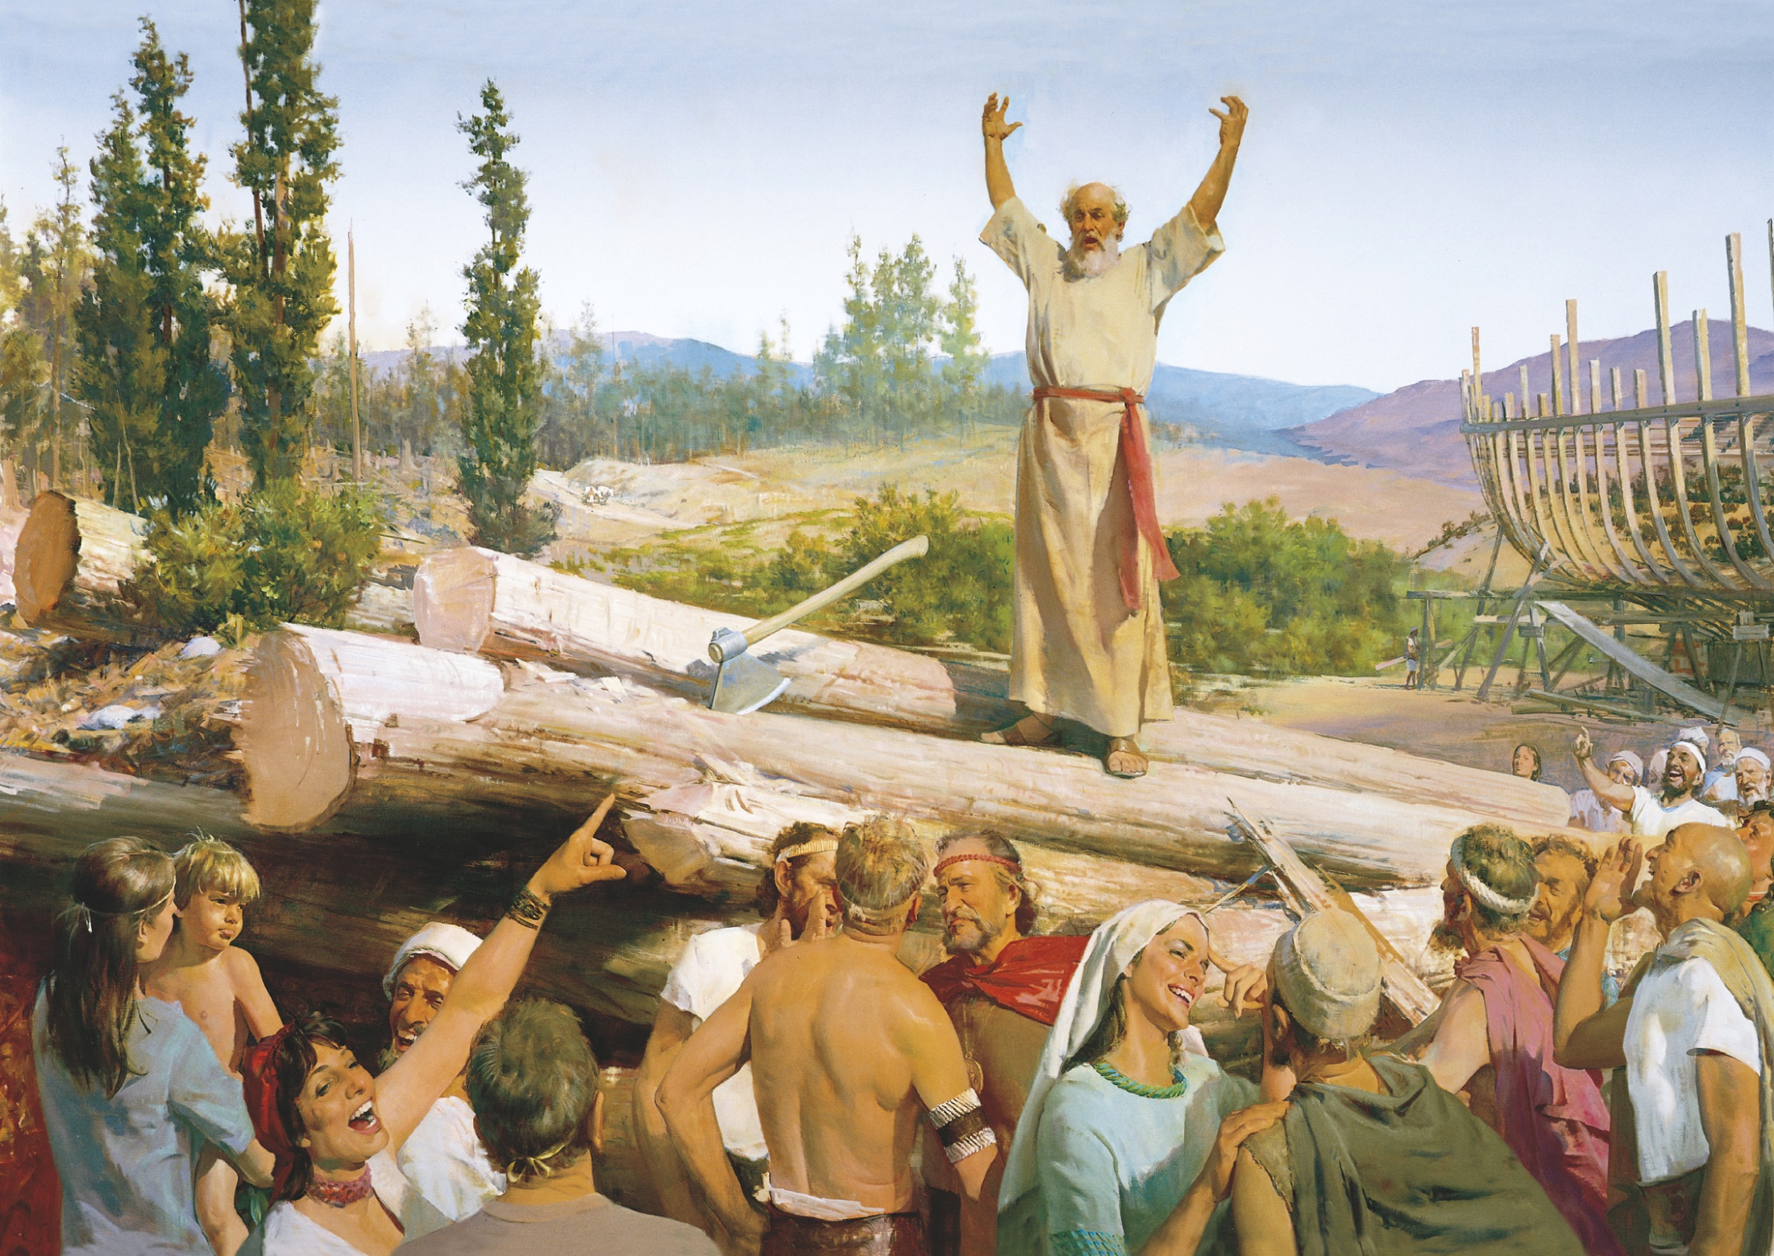

Slide 65
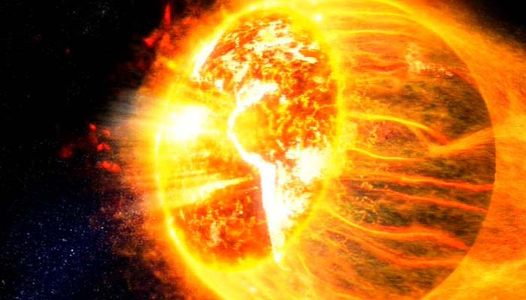
2 Peter 3:10 But the day of the Lord will come as a thief in the night, in which the heavens will pass away with a great noise, and the elements will melt with fervent heat; both the earth and the works that are in it will be burned up.

Slide 66
Matthew 24:40 "Then two men will be in the field: one will be taken and the other left. ⁴¹ "Two women will be grinding at the mill: one will be taken and the other left.
John 5:28 "Do not marvel at this; for the hour is coming in which all who are in the graves will hear His voice ²⁹ "and come forth -- those who have done good, to the resurrection of life, and those who have done evil, to the resurrection of condemnation.

Slide 67
Matthew 24:42 "Watch therefore, for you do not know what hour your Lord is coming. ⁴³ "But know this, that if the master of the house had known what hour the thief would come, he would have watched and not allowed his house to be broken into. ⁴⁴ "Therefore you also be ready, for the Son of Man is coming at an hour you do not expect.

Slide 68
Matthew 24:45 Who then is a faithful and wise servant, whom his master made ruler over his household, to give them food in due season? ⁴⁶ "Blessed is that servant whom his master, when he comes, will find so doing. ⁴⁷ "Assuredly, I say to you that he will make him ruler over all his goods. ⁴⁸ "But if that evil servant says in his heart, 'My master is delaying his coming,' ⁴⁹ "and begins to beat his fellow servants, and to eat and drink with the drunkards, ⁵⁰ "the master of that servant will come on a day when he is not looking for him and at an hour that he is not aware of, ⁵¹ "and will cut him in two and appoint him his portion with the hypocrites. There shall be weeping and gnashing of teeth.

Slide 69
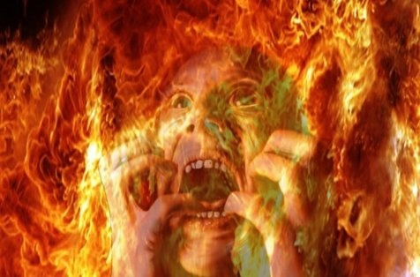

Slide 70
If Jesus came back right now, would you be ready?

